Slide 1
Music
Responsibility

Slide 2
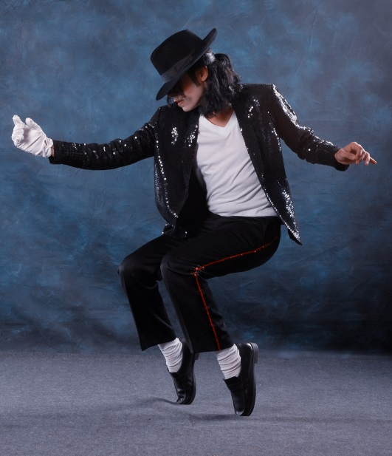
The artist/the song
The artist
Michael Jackson
He died…….
The song
Heal the world

Slide 3
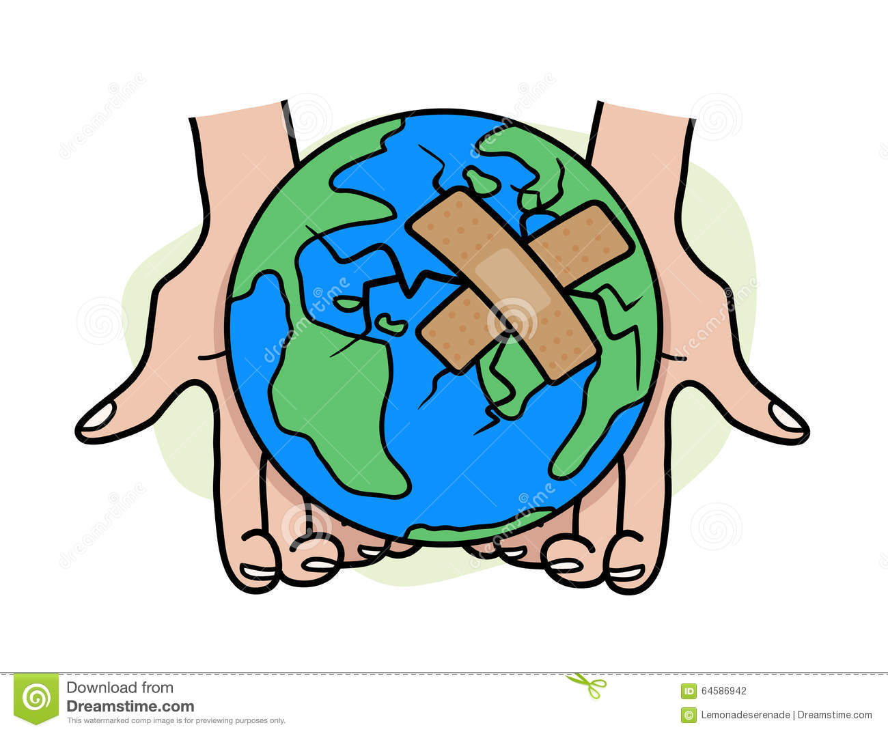
Responsibility
He sings about a better world (Han sjunger om en bättre värld)
He is making other people understand. (Han får andra människor att förstå)

